Slide 1

PCI DSS V3
PCI Data Security Standard (DSS):
Designed to ensure that ALL companies that accept, process, store or transmit credit card info maintain a secure environment
Managed by Security Standards Council
https://www.pcicomplianceguide.org/pci-faqs-2/

Slide 2
PCI DSS V3
PCI DSS:
SSC is an independent body that was created by the major payment card brands (Visa, MasterCard, American Express, Discover and JCB
6 Broad goals and 12 requirements
REF: PCI Best Practices For Implementing Security Awareness; https://www.pcisecuritystandards.org/documents/

Slide 3
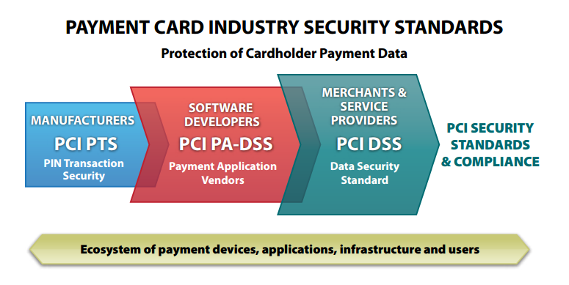
PCI DSS V3
https://www.pcisecuritystandards.org/documents/PCI%20SSC%20Quick%20Reference%20Guide.pdf

Slide 4
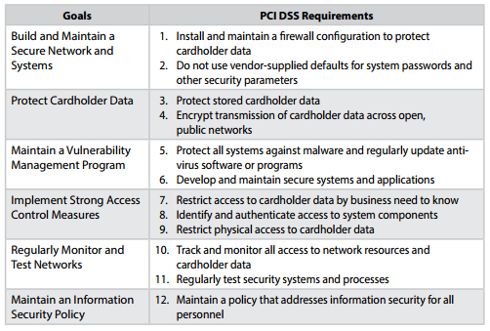
PCI DSS V3
https://www.pcisecuritystandards.org/documents/PCI%20SSC%20Quick%20Reference%20Guide.pdf

Slide 5
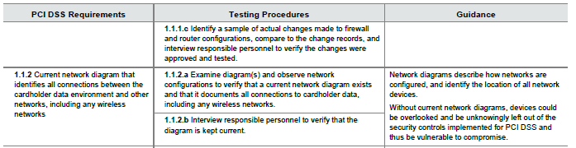
PCI DSS V3
REQUIREMENT

Slide 6
PCI DSS V3
TESTING PROCEDURES

Slide 7
PCI DSS V3
GUIDANCE

Slide 8
PCI DSS V3
REQMT | TEST PROCEDURES | GUIDANCE
7.1.4 Require documented approval by authorized parties specifying required privileges. | 7.1.4 Select a sample of user IDs & compare with documented approvals to verify that: -Documented approval exists for the assigned privileges -The approval was by authorized parties -That specified privileges match the roles assigned to the individual. | Documented approval (for example, in writing or electronically) assures that those with access and privileges are known and authorized by management, and that their access is necessary for their job function.

Slide 9
PCI DSS V3
REQMT | TEST PROCEDURES | GUIDANCE
8.1.4 Remove/ disable inactive user accounts within 90 days. | 8.1.4 Observe user accounts to verify that any inactive accounts over 90 days old are either removed or disabled. | Accounts that are not used regularly are often targets of attack since it is less likely that any changes (such as a changed password) will be noticed. As such, these accounts may be more easily exploited and used to access cardholder data.

Slide 10
PCI DSS V3
PCI is specific to the card environment to protect cardholder data
PCI controls are very specific and in-depth compared to generic and high-level controls of ISO27001
END

